Slide 1
Rise of totalitarianism
By

Slide 2
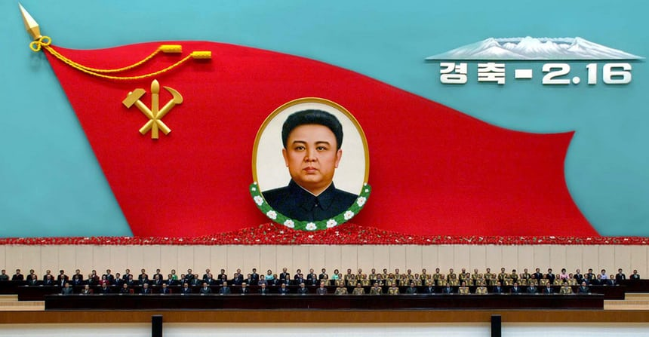
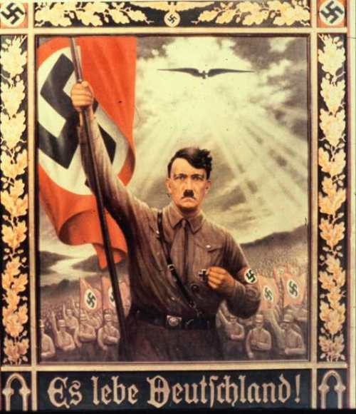
Cult of personality
Cult of personality is a term, which refers to a situation where a public figure is presented to the populace via propaganda as an amazing person who should be admired.(1)
(2)
(3)
All media outlets, in north Korea state how awesome of a person Kim Jong-un is and how great of a leader he is for the country.(1)
Adolf Hitler used portraits, inspiring speeches and mass rallies broadcasted to the entire nation to portray how great he was to the citizens of Germany. (1)

Slide 3
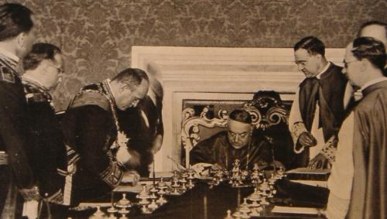
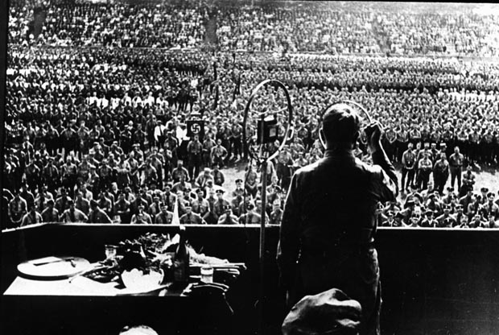
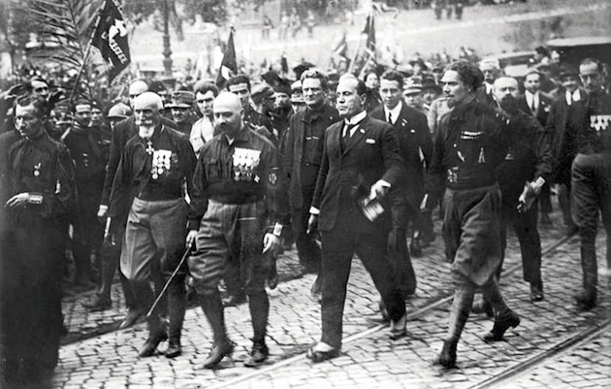
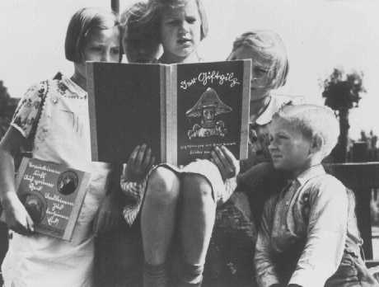
Indoctrination and mobilization of supporters
Mussolini Hitler
(5)
(7)
“Marriage of Convenience” (4)
Speeches (7)
(6)
(8)
Squadristi (4)
Propaganda (8)

Slide 4
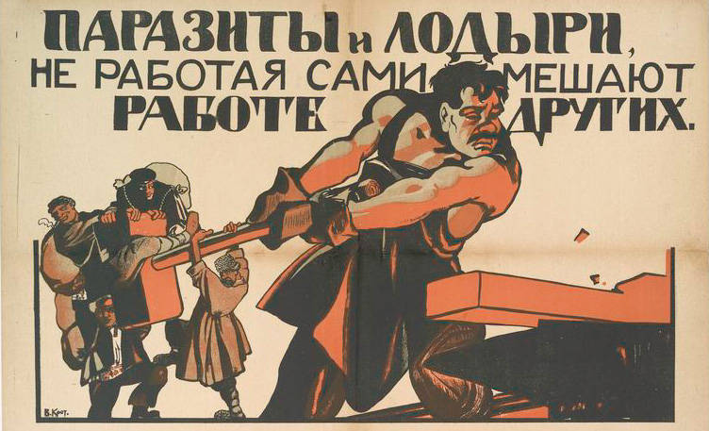
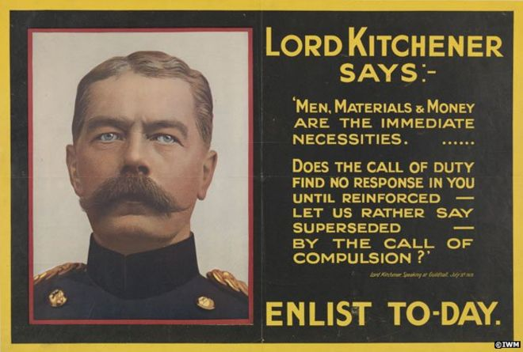
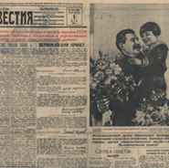
Propaganda and control of media
Stalin
Lord Kitchener
(11)
(9)
“Your Country Needs You”-Lord Kitchener the day after Britain declared war on Germany (11)
Use of posters during Russian revolution (9)
(10)
Pravda newspaper of the
Russian revolution (10)
(12)
Poster symbol of army and empire (12)

Slide 5
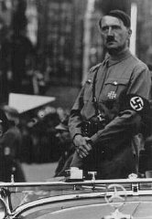
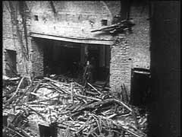
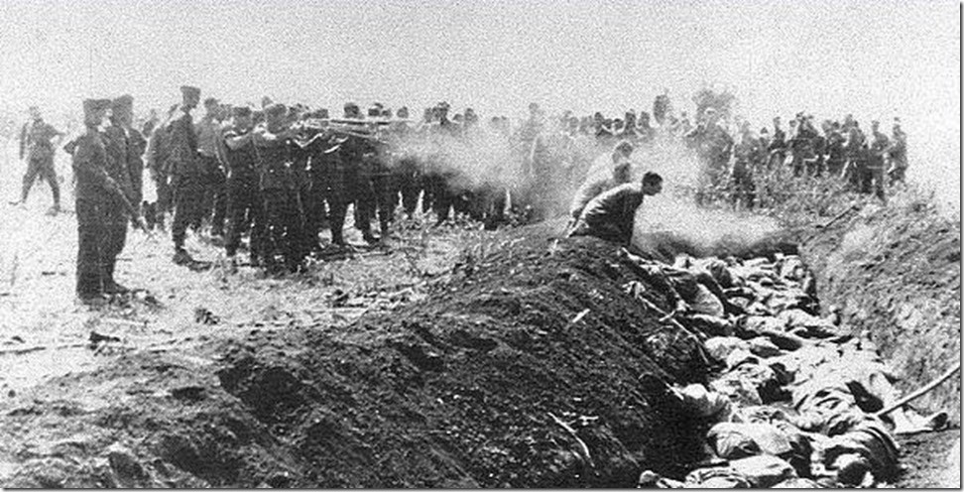
Terror/fear and violence
Stalin
sent many innocent people to their deaths, or to “gulags. Stalin said he was “cleansing” the Communist party of all the traitors to Russia(13)
Hitler
Hitler took away all privacy of citizens, individual rights and They arrested Socialists, Communists, trade union leaders, and others who had spoken out against the Nazi party; some were murdered.(15)
(14)
(15)

Slide 6
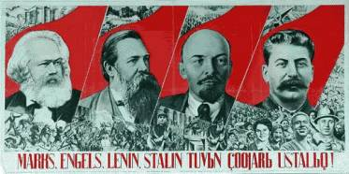
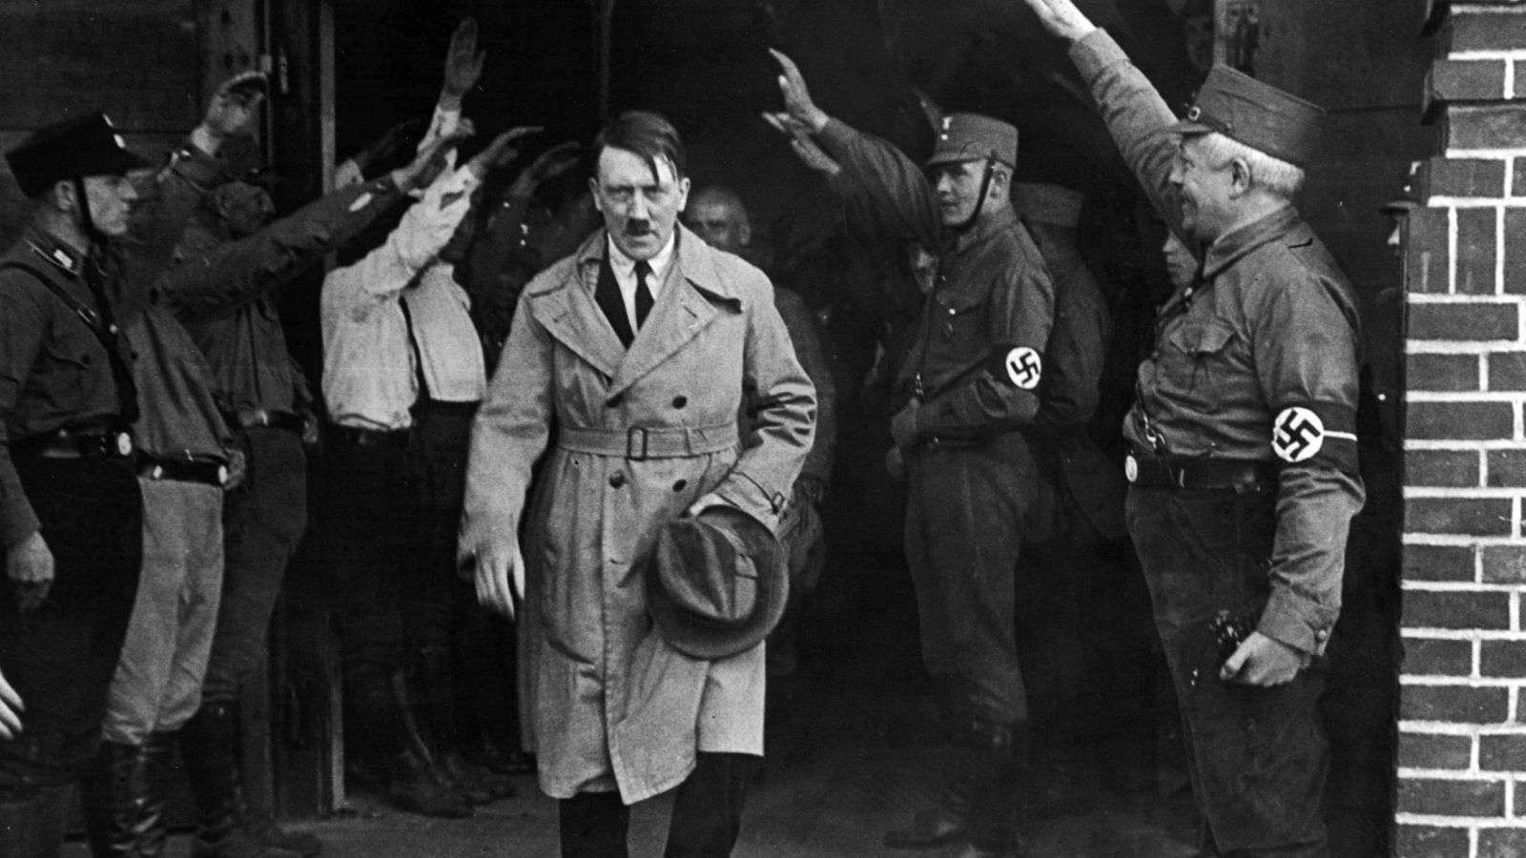
Removal of all opposition
Stalin
Stalin gained power over Trotsky through a number of campaigns of repression against groups which opposed the Communist Party and Stalin himself. (16)
Hitler
Hitler promised the disenchanted a better life and a new and glorious Germany. German government was lacked confidence and power, Hitler declared he would change that. (18)
(17)
(19)

Slide 7
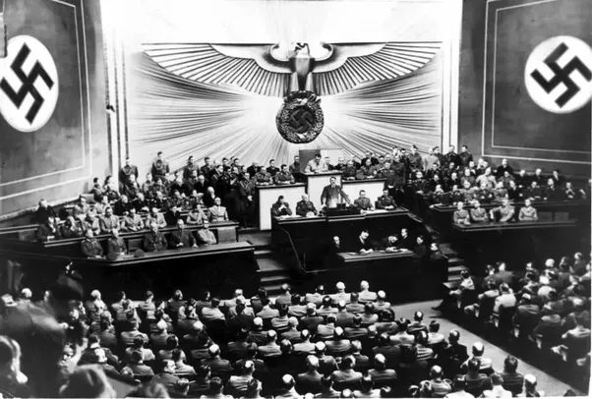
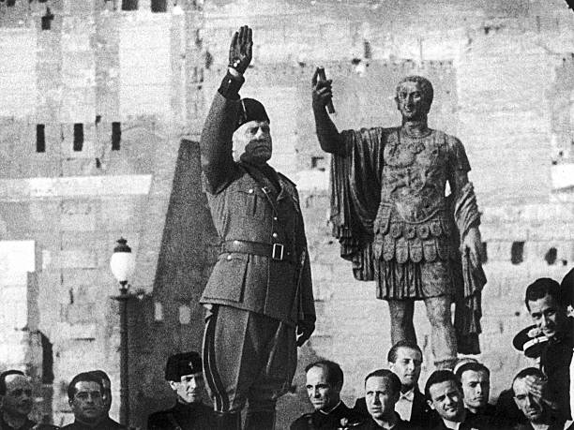
Aggressive militarism and the glorification of war
Hitler
Hitler shifted his central strategy to focus on breaking the alliance of his main opponents (Britain, the United States and the Soviet Union) by force.(20)
Mussolini
“thirst for military glory” (22)
(21)
(23)

Slide 8
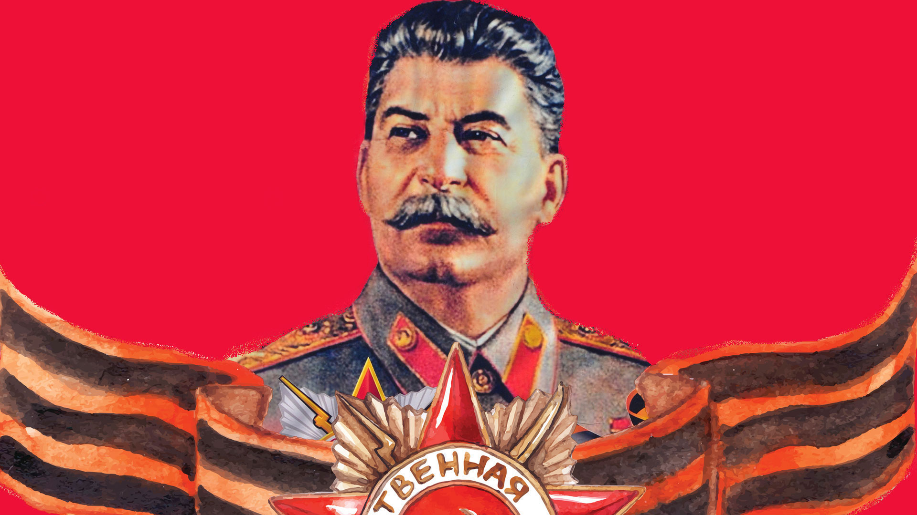
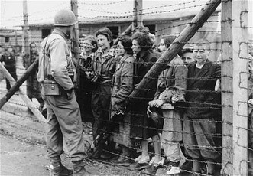
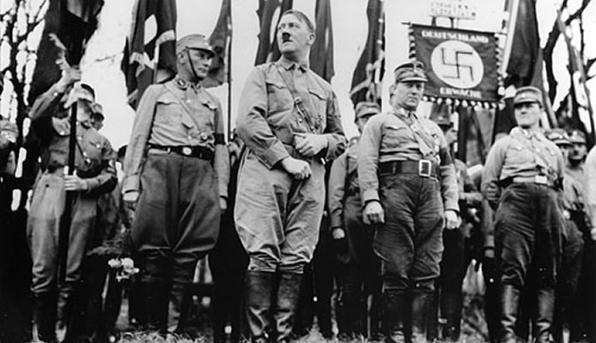
The promotion of radical beliefs
Hitler
Hitler spread his beliefs in racial "purity" and in the superiority of the "Germanic race“. the ideal "Aryan" was blond, blue-eyed, and tall. (24)
Stalin
“socialism in one country”
“revolution, devoid of ideological sentiment” (26)
(25)
(27)

Slide 9
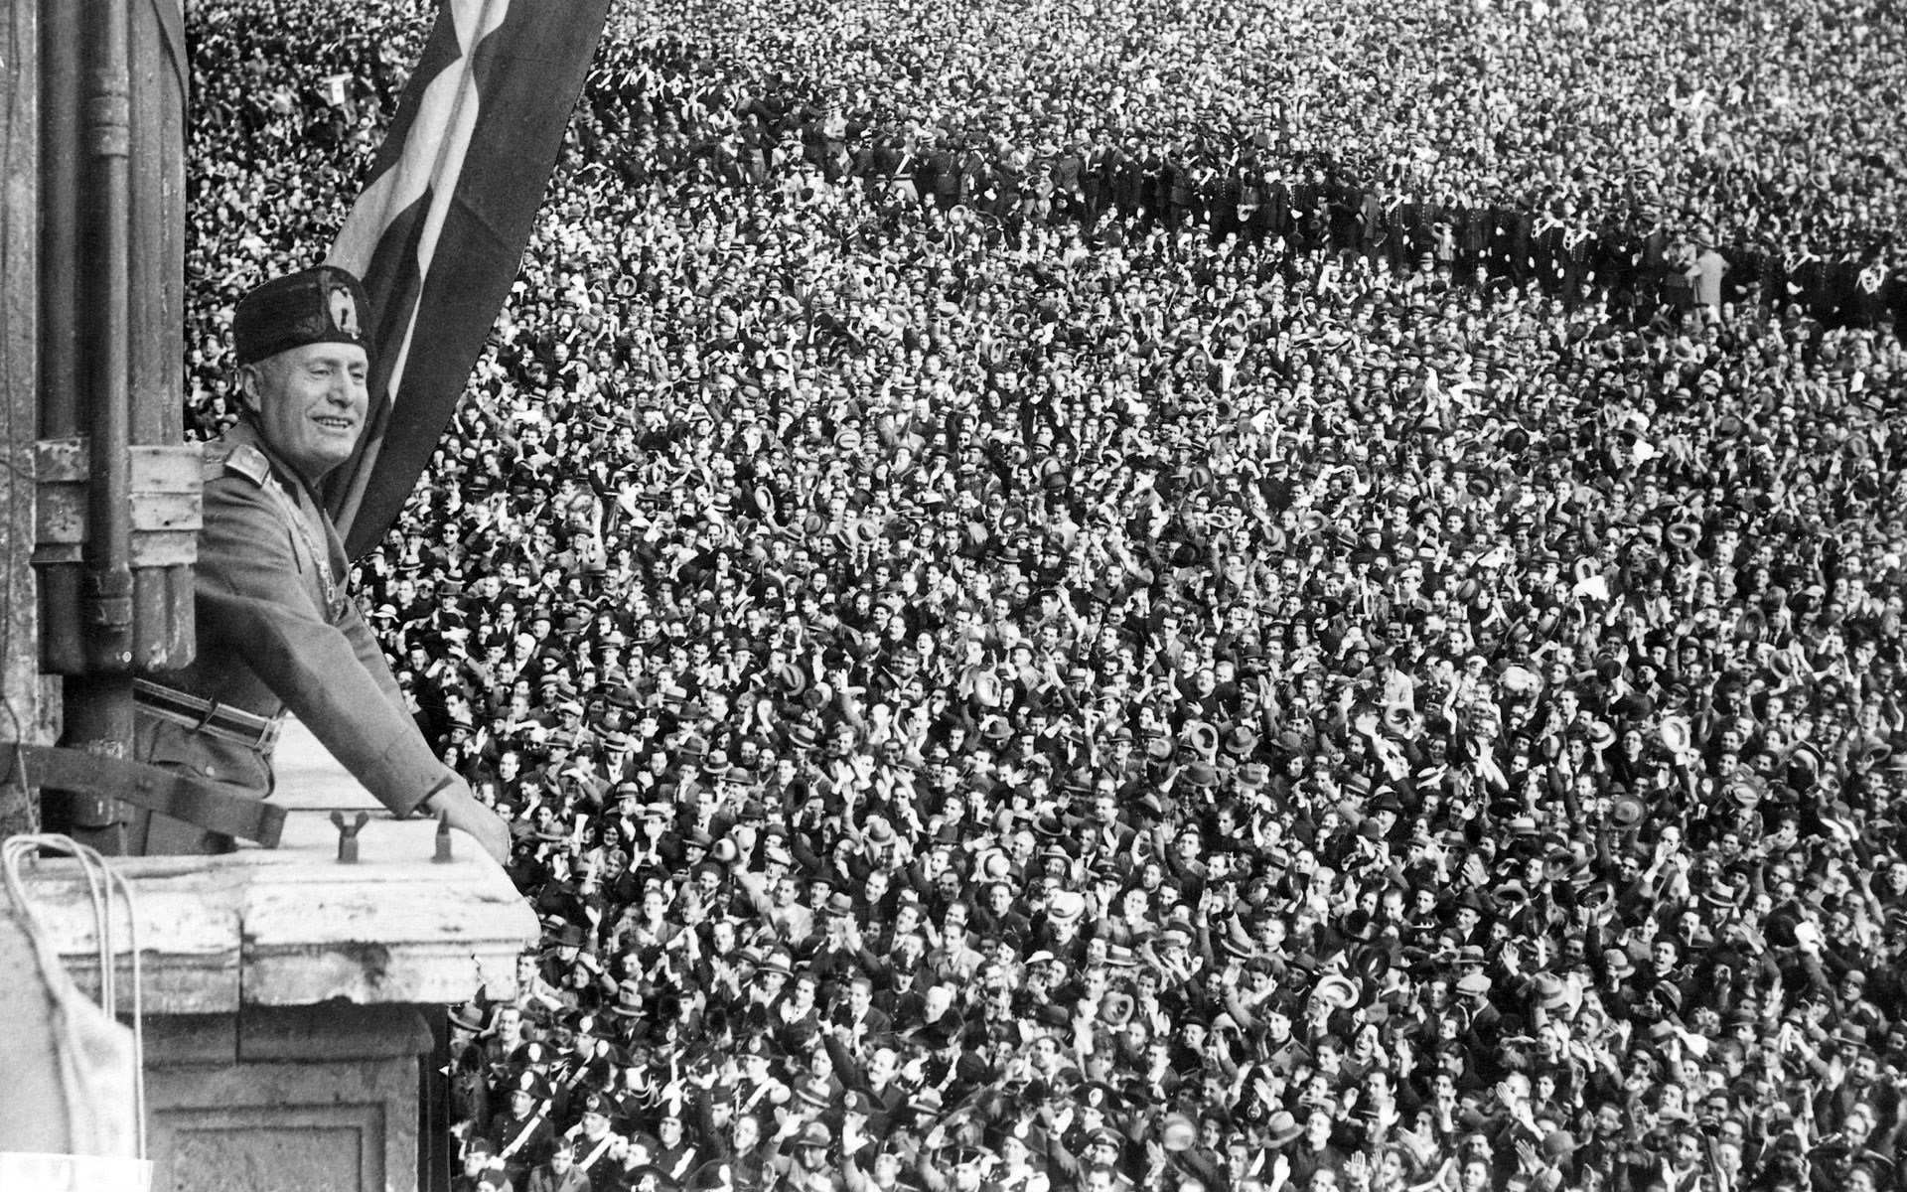
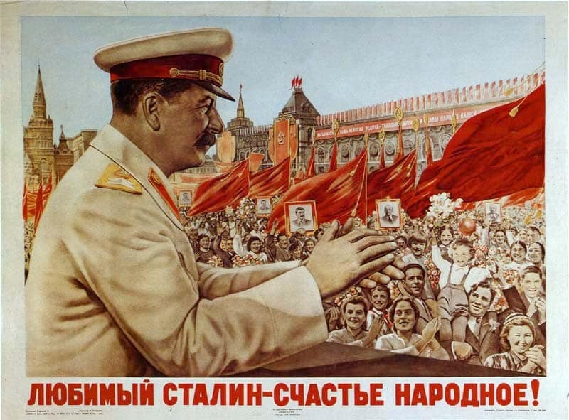
FAILURE OF DEMOCRACY THAT LEAD TO SUPPORT
Mussolini
Italy was promised resources after the war that were never given. Mussolini then created a coalition government that got support from multiple sources. (28)
Stalin
War should be avoided if all possible so all energy could be spent strengthening the regime and building industry. Stalin’s principals would bend and adapt to the foreign relations climate. (30)
(29)
(31)

Slide 10
(1)- What is a Cult of Personality? - Definition & Examples | Study.com. (2018) Retrieved March 13, 2018, from https://study.com/academy/lesson/what-is-a-cult-of-personality-definition-examples.html
(2)-Union. (2018) North Korea's Kim dynasty: the making of a personality cult | World news | The Guardian. Retrieved March 13, 2018, from https://www.theguardian.com/world/2015/feb/16/north-korea-kim-jong-il-birthday
(3)-German U-Boats. (2018) German Propaganda Posters - Hitler's Cult of Personality - Charles McCain. Retrieved March 13, 2018, from http://charlesmccain.com/2011/06/german-propaganda-posters-hitlers-cult-of-personality/
(4)-Giving Them A. (2018) What methods did Mussolini use to gather support from 1919-1925? | h.i.s.t.o.r.y. Retrieved March 14, 2018, from https://pallavigajjar.wordpress.com/2008/10/17/what-methods-did-mussolini-use-to-gather-support-from-1919-1925/
(5)-Review for The Pope and Mussolini | David Kertzer. (2018) Retrieved March 14, 2018, from http://www.davidkertzer.com/books/pope-and-mussolini/reviews
(6)-Plane And Scatter. (2018) Squadristi, March on Rome, Mussolini, Italian culture. Retrieved March 14, 2018, from http://www.italoamericano.org/story/2014-10-24/Squadristi
(7)-Instructor And Semester. (2018) How did Hitler Influence a Nation of People to Elect the Nazi Party? – Studio 395. Retrieved March 14, 2018, from https://sites.jmu.edu/studio395/how-did-hitler-influence-a-nation-of-people-to-elect-the-nazi-party/
(8)-Twittercard. (2018) Nazi Propaganda — Photograph. Retrieved March 14, 2018, from https://www.ushmm.org/wlc/en/media_ph.php?ModuleId=10005202&MediaId=819
(9)-Gabe Paoletti. (2018) Soviet Propaganda: Posters From The Era Of Stalin And World War II. Retrieved March 14, 2018, from http://allthatsinteresting.com/soviet-propaganda-posters-ww2#1
(10)-Squealer. Orwell. (2018) Propaganda - Animal Farm. Retrieved March 14, 2018, from https://animalfarmracheltsao.weebly.com/propaganda.html
(11)-Using This Site. (2018) 'Your country needs you' advertisement - The British Library. Retrieved March 14, 2018, from https://www.bl.uk/collection-items/your-country-needs-you
(12)-Flash Library To. (2018) Kitchener: The most famous pointing finger - BBC News. Retrieved March 14, 2018, from http://www.bbc.com/news/magazine-28642846
(13)-Out Team Of. (2018) How did Stalin control Russia from 1924-1953? - GCSE History - Marked by Teachers.com. Retrieved March 15, 2018, from http://www.markedbyteachers.com/gcse/history/how-did-stalin-control-russia-from-1924-1953.html
(14)-Eliminating Divergent Ideologies. (2018) Crisis and Achievement: Soviet Purges. Retrieved March 15, 2018, from http://crisissome.blogspot.ca/2015/06/soviet-purges.html
(15)- Twittercard. (2018) Nazi Terror Begins. Retrieved March 15, 2018, from https://www.ushmm.org/wlc/en/article.php?ModuleId=10005686
(16)- Out Team Of. (2018) How true is it to say that Stalin effectively removed opposition to the exercise of his personal power up to 1941? - GCSE History - Marked by Teachers.com. Retrieved March 15, 2018, from http://www.markedbyteachers.com/gcse/history/how-true-is-it-to-say-that-stalin-effectively-removed-opposition-to-the-exercise-of-his-personal-power-up-to-1941.html
(17)- His Outstanding Ability. (2018) Stalin Takes Power. Retrieved March 15, 2018, from http://www.johndclare.net/Russ9.htm
(18)- Twittercard. (2018) Hitler Comes to Power. Retrieved March 15, 2018, from https://www.ushmm.org/outreach/en/article.php?ModuleId=10007671
(19)-Annalisa Merelli. (2018) Adolf Hitler was nominated for the Nobel Peace Prize in a darkly ironic letter by Erik Gottfrid Christian Brandt — Quartz. Retrieved March 15, 2018, from https://qz.com/803976/adolf-hitler-was-nominated-for-the-nobel-peace-prize-in-a-darkly-ironic-letter-by-erik-gottfrid-christian-brandt/
(20)-A British Gas. (2018) Adolf Hitler - World War II - HISTORY.com. Retrieved March 15, 2018, from https://www.history.com/topics/world-war-ii/adolf-hitler
(21)-Soviet Forces Led. (2018) Why did Hitler declare war on the USA? - Quora. Retrieved March 15, 2018, from https://www.quora.com/Why-did-Hitler-declare-war-on-the-USA
(22)-Different Sources As. (2018) WWII: Road To War In Middle East And North Africa Foton och bilder | Getty Images. Retrieved March 15, 2018, from https://www.gettyimages.se/h%C3%A4ndelse/road-to-war-in-middle-east-and-north-africa-185175942#/italian-prime-minister-benito-mussolini-and-king-victor-emmanuel-iii-picture-id98950343
(23)-Different Sources As. (2018) WWII: Road To War In Middle East And North Africa Foton och bilder | Getty Images. Retrieved March 16, 2018, from https://www.gettyimages.se/h%C3%A4ndelse/road-to-war-in-middle-east-and-north-africa-185175942#/mussolini-receiving-the-islam-sword-at-tripoli-in-lybia-on-march-1937-picture-id107413707
(24)-Twittercard. (2018) Nazi Racism. Retrieved March 16, 2018, from https://www.ushmm.org/outreach/en/article.php?ModuleId=10007679
(25)-Jewish People. (2018) Why Did Hitler Hate Jews? - The Holocaust and World War 2. Retrieved March 16, 2018, from https://holocaustworldwar2sweeney.weebly.com/why-did-hitler-hate-jews.html
(26)-Intellectuals And Rhetoricians. (2018) Stalinism | political doctrine | Britannica.com. Retrieved March 16, 2018, from https://www.britannica.com/topic/Stalinism
(27)- One Of Russia. (2018) History: Russians Vote for Stalin, State Promotes Strident Nationalism. Retrieved March 16, 2018, from http://www.vision.org/visionmedia/history-Russia-Stalin/10698.aspx
(28)-Social Unrest. (2018) Between the wars – failure of the young democracies | deutschland.de - How Germany ticks. Retrieved March 16, 2018, from https://www.deutschland.de/en/topic/politics/germany-europe/between-the-wars-failure-of-the-young-democracies
(29)-Riots Before A. (2018) The relationship between Mussolini and calcio. Retrieved March 16, 2018, from https://thesefootballtimes.co/2015/07/20/the-relationship-between-mussolini-and-calcio/
(30)-Moscow. (2018) A Spectacular Failure: On Stalin and Stalinism. Retrieved March 16, 2018, from http://uclailliterati.blogspot.ca/2005/06/on-stalin-and-stalinism.html
(31)-The Late. (2018) Stalinism: Stalin's Economic Policy (1930-40) - SchoolWorkHelper. Retrieved March 16, 2018, from https://schoolworkhelper.net/stalinism-stalins-economic-policy-1930-40/

